Slide 1
An Empirical Study On Modelling And Prediction Of Bitcoin Prices
With Bayesian Neural Networks Using Blockchain Information
Rose Mary Abraham
Class No: 53 S7 BTech CSE
Dept. of CSE, MACE Kothamangalam
August 13, 2018

Slide 2
CONTENTS
Bitcoin
Blockchain
Hashing
Bayesian Neural Networks
Time series Modelling
Resampling
Data Specification
Using Linear Regression Analysis
Using Bayesian Neural Networks
Conclusion

Slide 3

BITCOIN
The first decentralized digital currency
Uses cryptography to control its creation & management
Created & held electronically in a P2P open ledger called BLOCKCHAIN
Ledger is produced by people using software that solves mathematical problems

Slide 4

BLOCKCHAIN
technology behind bitcoin
public ledger that holds bitcoin transactions
chain of blocks
Proof of work

Slide 5
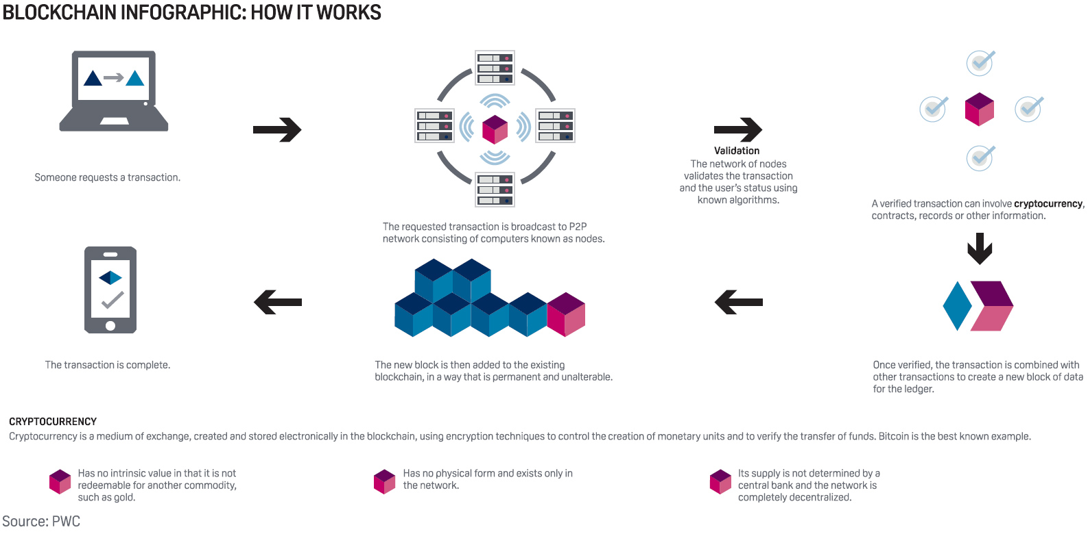

Slide 6
Centralized Power
Private Ledger
Decentralized Power
Public
Ledger
Prone to Hacks
Double Spending
Immutable to Hacks
No Double Spending

Slide 7

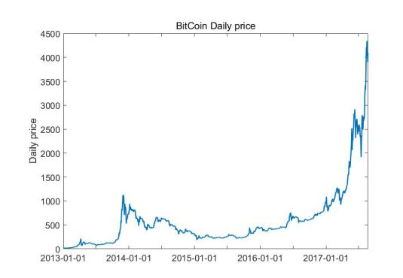
2009 → basically nothing
Sept 2011 → $5
Aug 2017 → $4000
Aug 2018 → $7101.37
Bitcoin Supply : SB = PBB
Bitcoin Demand : DB = _PE_
V
Equilibrium : PB = _PE_
VB
Notes:
On 22 may 2010, Laszlo Hanyecz made the first real-world transaction by buying two pizza in Jacksonville, Florida for 10,000 BTC.
BTC = 4,87,362.05 Rs

Slide 8
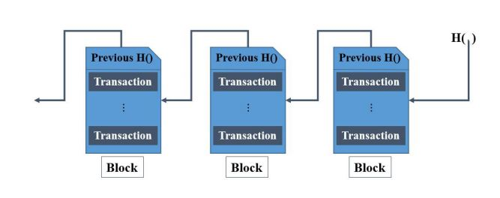
Hashing..
Taking an input string of any length & giving out an output of fixed length
Hashing algorithm : SHA 256
“deterministic”
Cryptographic hash functions –
“quick computation”
“collision resistant”
Hacker Scenario
Proof of work risks:
Blockchain forks
51% problem
Capacity limit of Blockchain
Notes:
Small changes

Slide 9
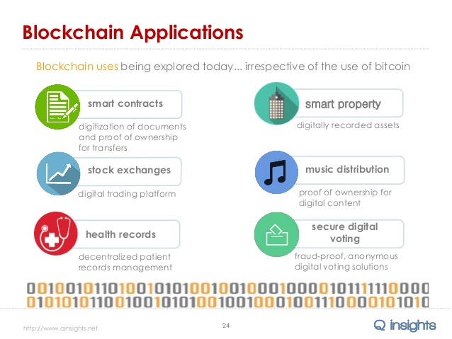


Slide 10
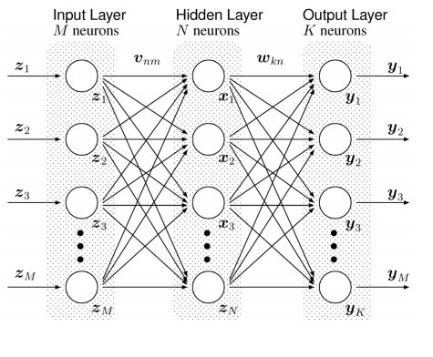
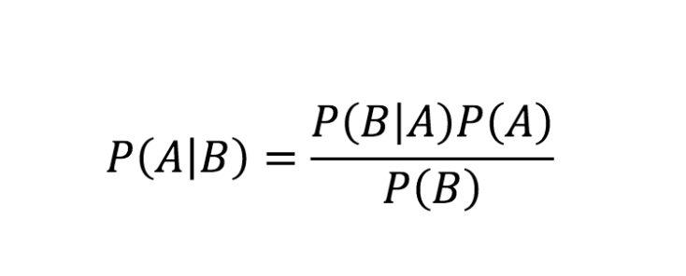
BAYESIAN NEURAL NETWORKS
Bayes Rule
It is a transformed Multilayer Perceptron
Backpropagation
Delta Rule

Slide 11
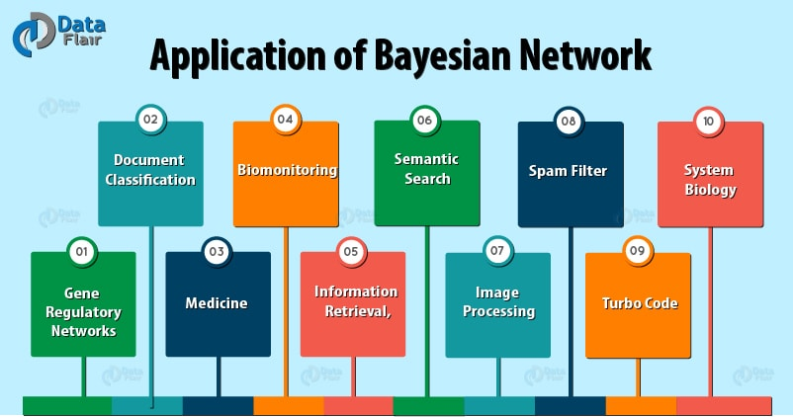

Slide 12
TIME SERIES MODELLING
time series → series of data points indexed in time order
a time series is a sequence taken at successive equally spaced points in time
it is a sequence of discrete time data.
Time series analysis comprises methods for analysing time series data in order to extract meaningful statistics and other characteristics of the data.
Time series forecasting is the use of a model to predict future values based on previously observed values.

Slide 13
RESAMPLING
Drawing repeated samples from the original data samples.
1. Bootstrapping
2. Cross-validation

Slide 14

RESAMPLING - BOOTSTRAP METHOD
1) We have the original data set D, with the number of N.
2) Produce B different bootstrap data set, Z1, Z2,…, ZB.
Dataset Zi is generated by sampling from original data set D with replacement.
3) The machine is trained from each bootstrap data set.
4) Accuracy of the machine is calculated.

Slide 15


RESAMPLING – CROSS VALIDATION METHOD
1. Divide the original data set into K equal-sized parts data set C1, C2, …, Ck, without replacement.
nk – number of each partial set defined by n/k.
2. Compute total accuracy
3. Estimated standard deviation of the cross-validation

Slide 16
DATA SPECIFICATION
Blockchain Information
Avg block size
Trans/blck
Median confirm time
Hash rate
Difficulty
Miner’s rev
Cost% of trans
Log price of Bitcoin
S&P 500
Eurostoxx
DOW30
NASDAQ
Crude Oil
Gold
Nikkei225
GBP
JPY
CHE
CNY
EUR
Macro economic development
Input variables
Response variables
Global Currency Ratio (/USD)
Log vol. of Bitcoin

Slide 17
Using LINEAR REGRESSION ANALYSIS
Model assumption
Multicollinearity Problem
Eliminate variables with large VIF values
Residual assumption
Generate histogram residuals of each model

Slide 18
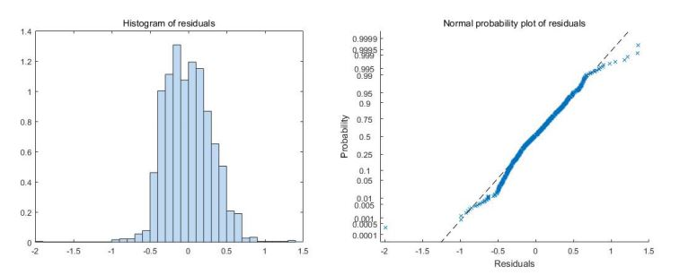
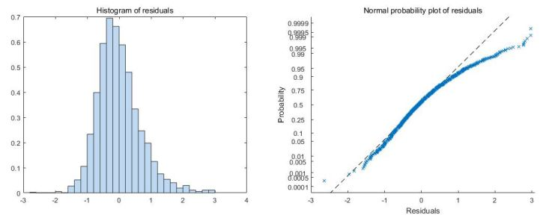
log
price
bell-typed &
symmetric
log
volatility
Positive-
skewed

Slide 19
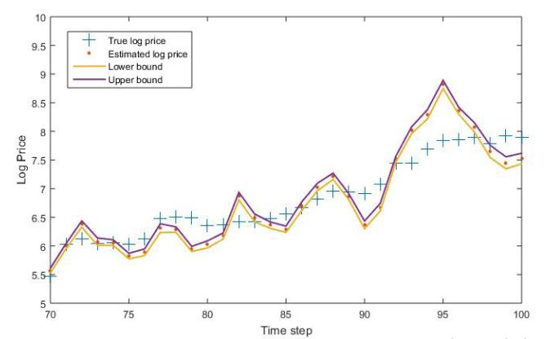
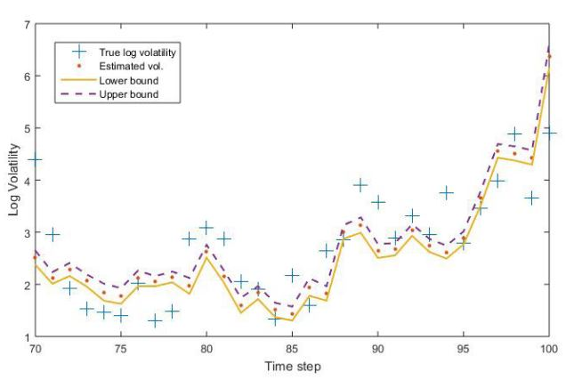
log volatility predictions
log price predictions

Slide 20
Using BAYESIAN NEURAL NETWORKS
25 + 16 input variables & 2 response variables
10 fold cross-validation → 9/10 N training data & 1/10 N test data
Performance measured using RMSE & MAPE

Slide 21


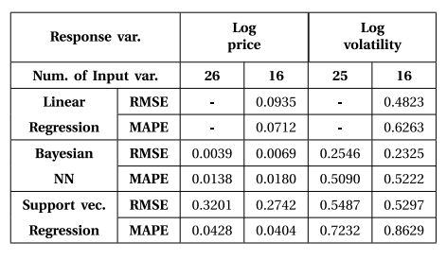
Testing Error
Training error

Slide 22
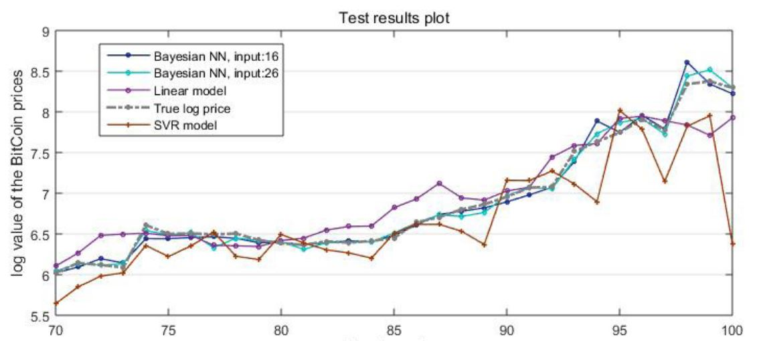
Bitcoin log price

Slide 23
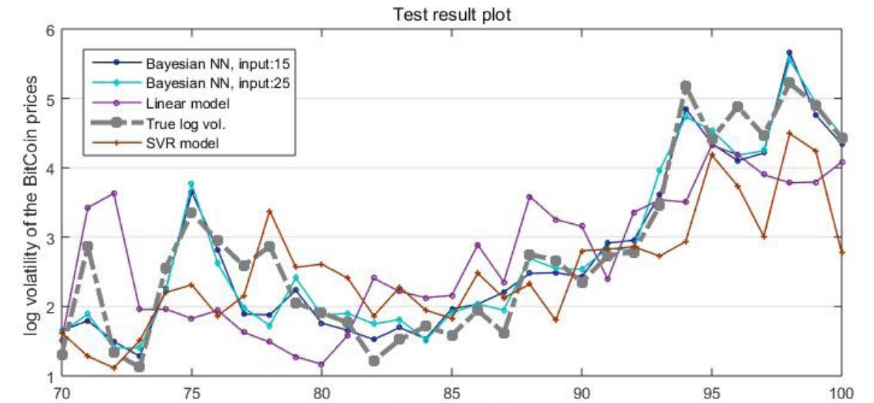
Bitcoin log volatility

Slide 24
CONCLUSION
Blockchain variables were crucial in predicting bitcoin prices.
Adoption of BNN made the predictive performance better.
Both bitcoin price & volatility were predicted with better precision.
BNN models outperform SVR & linear regression models

Slide 25
THANK YOU

